Slide 1
6. Introduction to Ethereum
Mastering Ethereum - Building Smart Contracts and DApps, 2018

Slide 2
What is Ethereum?
Ethereum is often described as “the world computer.”
From a computer science perspective, Ethereum is a deterministic but practically unbounded state machine, consisting of a globally accessible singleton state and a virtual machine that applies changes to that state.
From a more practical perspective, Ethereum is an open source, globally decentralized computing infrastructure that executes programs called smart contracts. It uses a blockchain to synchronize and store the system’s state changes, along with a cryptocurrency called ether (ETH) to meter and constrain execution resource costs.
Ethereum platform enables developers to build powerful decentralized applications with built-in economic functions.
While providing high availability, auditability, transparency, and neutrality, it also reduces or eliminates censorship and reduces certain counterparty risks.

Slide 3
Ethereum compared to Bitcoin
Ethereum shares common elements with other open blockchains
A P2P network connecting participants, A Byzantine fault–tolerant consensus algorithm for synchronization of state updates (moving from proof-of-work to proof-of-stake since Sept. 2022), the use of cryptographic primitives such as digital signatures and hashes, and a digital currency (ether).
Difference
While the digital currency ether is both integral to and necessary for the operation of Ethereum, ether is intended as a utility currency to pay for use of the Ethereum platform as the world computer.
Unlike Bitcoin, which has a very limited scripting language, Ethereum is designed to be a general-purpose programmable blockchain that runs a virtual machine capable of executing code of arbitrary and unbounded complexity. Ethereum’s language is Turing complete.

Slide 4
Ethereum vs. Bitcoin (1/3)
Ref. Ethereum vs Bitcoin: A Comparison Guide
Currency
Ether is built to fuel Ethereum’s network and power transactions, while Bitcoin is known to be the currency of real-world operations.
Design
Think of digital currency when you think of Bitcoin. Speak of smart contracts when you talk about Ethereum.
Purpose
Bitcoin is a store of cash and a way to transfer money. Ethereum is also a way to give money to others, but only when certain events happen. Ethereum also differs in that it serves as a building platform for DApps/smart contracts that allow it to submit value-representing tokens. Such values can be anything other than digital currencies, making them separate from bitcoin.

Slide 5
Ethereum vs. Bitcoin (2/3)
Transactions
Transactions of Bitcoin look like this:
John sends out 10 BTC (Bitcoins) to Lily.
Transactions of Ethereum run on smart contracts and look like this:
Send 10 ETH (Ether) from John to Lily if the balance of John is 20 ETH, and the date is 25.10.2019.
Bitcoin transactions are manual, and Ethereum transactions are automatic (programmable).
Speed of Transaction
The time of the Ethereum block or transaction speed is only seconds. The block time of Bitcoin, however, is minutes.

Slide 6
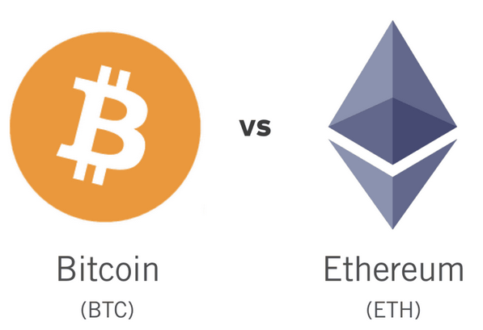
Ethereum vs. Bitcoin (3/3)
Coin Suppliance
Bitcoin is limited to 21 million coins. It provides a balanced supply and demand for a store of inventory. Ethereum, however, is not limited to this. Ether’s output is continuous. But the supply of Ether will slow down a lot over time. Many blockchain experts have claimed that the total number of coins would not be more than 100,000,000 ETH in the future. (?)

Slide 7
Ethereum and Turing Completeness (1/2)
Alan Turing defined a system to be Turing complete if it can be used to simulate any Turing machine. Such a system is called a Universal Turing machine (UTM).
Ethereum can compute any algorithm that can be computed by any Turing machine, given the limitations of finite memory.
Ethereum’s groundbreaking innovation is to combine the general-purpose computing architecture of a stored-program computer with a decentralized blockchain, thereby creating a distributed single-state (singleton) world computer.
Turing completeness is very dangerous, particularly in open access systems like public blockchains, because of the halting problem.

Slide 8
Ethereum and Turing Completeness (2/2)
Ethereum introduces a metering mechanism called gas. As the EVM executes a smart contract, it carefully accounts for every instruction.
Each instruction has a predetermined cost in units of gas. When a transaction triggers the execution of a smart contract, it must include an amount of gas that sets the upper limit of what can be consumed running the smart contract.
The EVM will terminate execution if the amount of gas consumed by computation exceeds the gas available in the transaction to limit the resources that any program can consume.
Ether needs to be sent along with a transaction and it needs to be explicitly earmarked for the purchase of gas, along with an acceptable gas price.
The price of gas is not fixed. Gas is purchased for the transaction, the computation is executed, and any unused gas is refunded back to the sender of the transaction.

Slide 9
From General-Purpose Blockchains to DApps
Ethereum’s vision expanded to become a platform for programming DApps. DApps represent a broader perspective than smart contracts.
A DApp is, at the very least, a smart contract and a web user interface. More broadly, a DApp is a web application that is built on top of open, decentralized, peer-to-peer infrastructure services.
A DApp is composed of at least:
Smart contracts on a blockchain
A web frontend user interface
Many DApps include other decentralized components, such as:
A decentralized (P2P) storage protocol and platform
A decentralized (P2P) messaging protocol and platform

Slide 10

The Third Age of the Internet
In 2004 the term “Web 2.0” came to prominence, describing an evolution of the web toward user-generated content, responsive interfaces, and interactivity.
Web 2.0 is not a technical specification, but rather a term describing the new focus of web applications.
The concept of DApps is meant to take the World Wide Web to its next natural evolutionary stage, introducing decentralization with peer-to-peer protocols into every aspect of a web application.
Web3 represents a new vision and focus for web applications: from centrally owned and managed applications, to applications built on decentralized protocols.

Slide 11
Ethereum’s Development Culture (1/2)
In Bitcoin, development is guided by conservative principles: all changes are carefully studied to ensure that none of the existing systems are disrupted.
For the most part, changes are only implemented if they are backward compatible. Existing clients are allowed to opt-in, but will continue to operate if they decide not to upgrade.
In Ethereum, by comparison, the community’s development culture is focused on the future rather than the past.
The (not entirely serious) mantra is “move fast and break things.” If a change is needed, it is implemented, even if that means invalidating prior assumptions, breaking compatibility, or forcing clients to update.

Slide 12
Ethereum’s Development Culture (2/2)
Ethereum’s development culture is characterized by rapid innovation, rapid evolution, and a willingness to deploy forward-looking improvements, even if this is at the expense of some backward compatibility.
What this means to you as a developer is that you must remain flexible and be prepared to rebuild your infrastructure as some of the underlying assumptions change.
You can’t simply “upgrade” your smart contracts. You must be prepared to deploy new ones, migrate users, apps, and funds, and start over.
In order to “evolve” the platform, you have to be ready to scrap and restart your smart contracts, which means you have to retain a certain degree of control over them.
Eventually, the development of the Ethereum platform will slow down and its interfaces will become fixed.

Slide 13
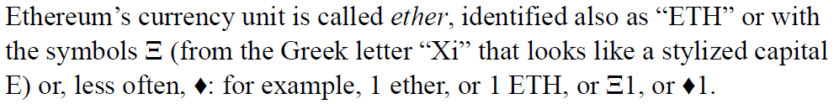
Ethereum Basics
Ether Currency Units
Choosing an Ethereum Wallet
MetaMask is a browser extension wallet that runs in your browser.
Ropsten Test Network: Ethereum public test blockchain and network. ETH on this network has no value.
The fees in Ethereum are charged in a virtual currency called gas.
You pay for the gas with ether, as part of the transaction.
One ether = 1,000,000,000,000,000,000 wei (10¹⁸).

Slide 14
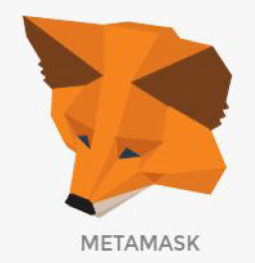
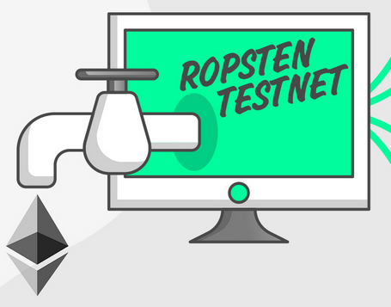
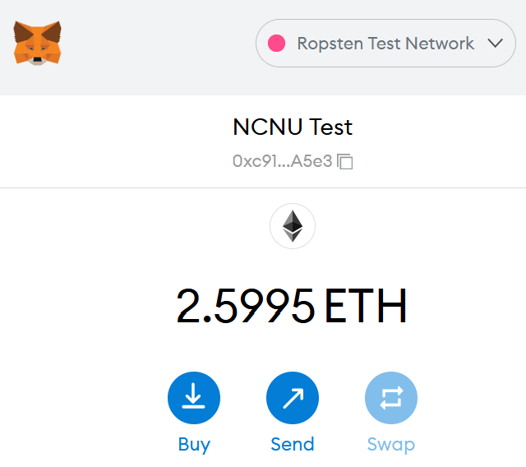

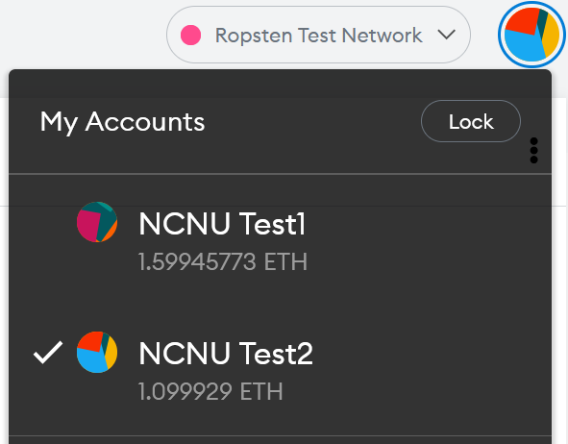
Exercise-2: Using Ropsten Test Network (1/2)
Sepolia
Install MetaMask
Connect to Ropsten Test Network
Get Ether from MetaMask Faucet
Check your Asset in Etherscan Explorer
Send some Test Ether to the teacher’s address:
0xc9192277ea18ff49618E412197C9c9eaCF43A5e3
0xd384B044f3e7b3DbcD0b4195a58342919A9BDe61

Slide 15
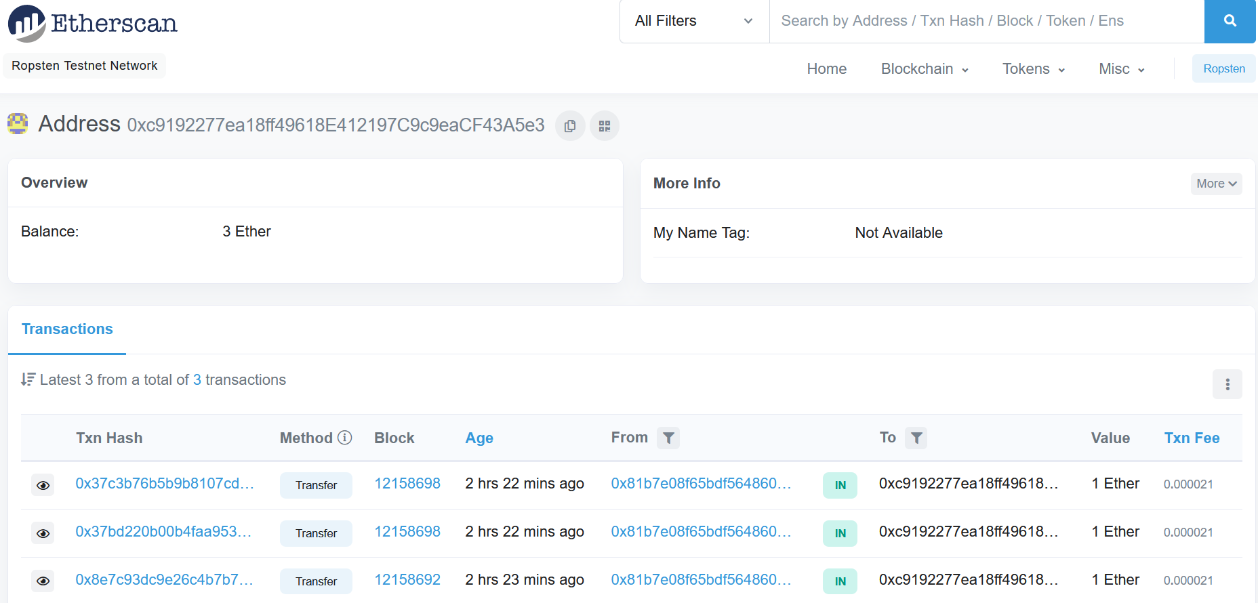
Exercise-2: Using Ropsten Test Network (2/2)

Slide 16
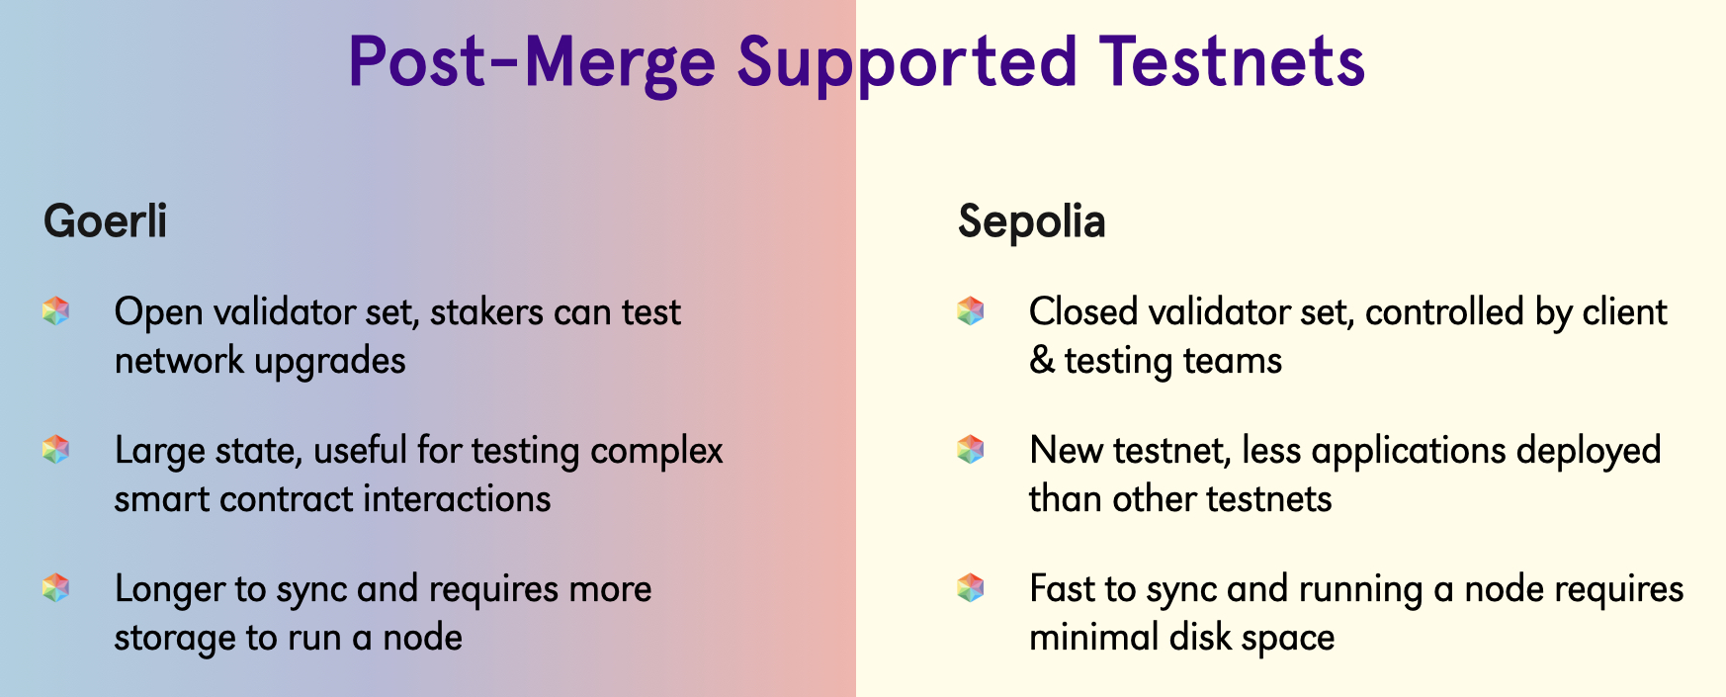
Ref. Ropsten, Rinkeby & Kiln Deprecation Announcement
The Ropsten testnet, which ran through The Merge on June 8, 2022, will be shut down in Q4 2022.
The Rinkeby testnet will not run through The Merge. It is being replaced by Sepolia, and will be shut down roughly one year after Sepolia has transitioned to proof-of-stake, around Q2/Q3 2023.
Developers who currently use Ropsten/Rinkeby as a staging/testing environment should migrate to Goerli or Sepolia.

Slide 17
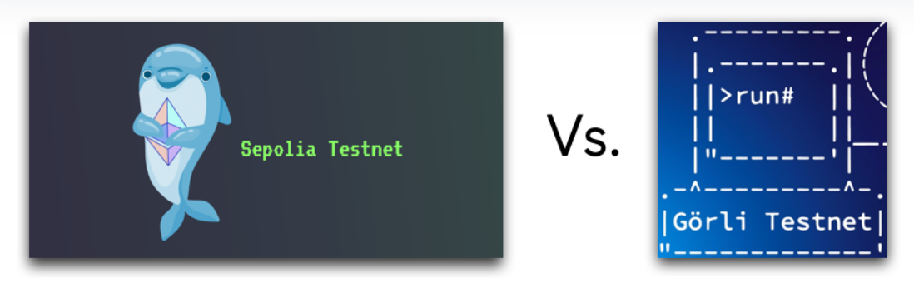
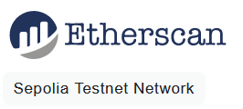
Ref. Sepolia vs. Goerli
https://moralis.io/sepolia-testnet-guide-what-is-the-sepolia-testnet/
https://sepolia.etherscan.io/

Slide 18
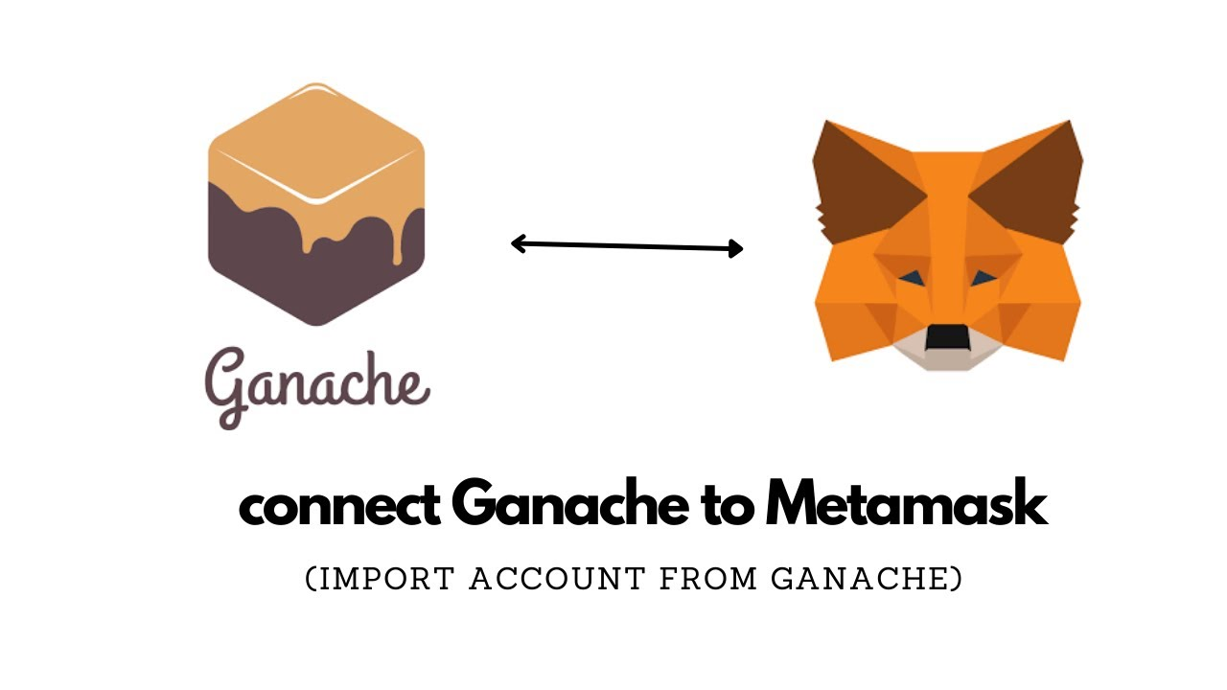
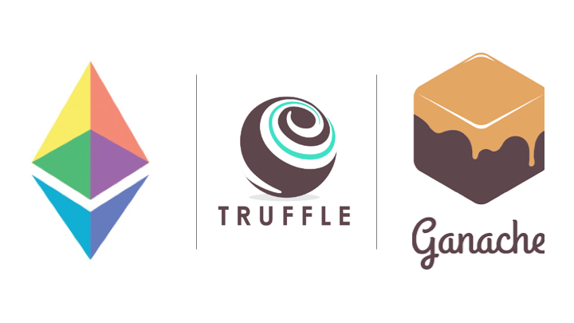
Exercise-3: Using Ganache
Using Ganache local blockchain for fast development
1. Install npm, truffle, and ganache
2. Editing truffle_config.js for connecting to Ganache
3. Using the same mnemonic to use the same accounts
4. Test network connection via truffle console
5. Connect Ganache to MetaMask

Slide 19
Introducing the World Computer
Ether is meant to be used to pay for running smart contracts, which are computer programs that run on an emulated computer called the Ethereum Virtual Machine (EVM).
The EVM is a global singleton, meaning that it operates as if it were a global, single-instance computer, running everywhere.
Each node on the Ethereum network runs a local copy of the EVM to validate contract execution, while the Ethereum blockchain records the changing state of this world computer as it processes transactions and smart contracts.

Slide 20
Externally Owned Accounts and Contracts (1/2)
The type of account you created in the MetaMask wallet is called an externally owned account (EOA).
Externally owned accounts are those that have a private key; having the private key means control over access to funds or contracts.
The other type of account is a contract account. A contract account has smart contract code, which a simple EOA can’t have.
A contract account does not have a private key. Instead, it is owned (and controlled) by the logic of its smart contract code: the software program recorded on the Ethereum blockchain at the contract account’s creation and executed by the EVM.
Contracts have addresses, just like EOAs. Contracts can also send and receive ether, just like EOAs.

Slide 21
Externally Owned Accounts and Contracts (2/2)
However, when a transaction destination is a contract address, it causes that contract to run in the EVM, using the transaction, and the transaction’s data, as its input.
In addition to ether, transactions can contain data indicating which specific function in the contract to run and what parameters to pass to that function. In this way, transactions can call functions within contracts.
Note that because a contract account does not have a private key, it cannot initiate a transaction.
Only EOAs can initiate transactions, but contracts can react to transactions by calling other contracts, building complex execution paths.

Slide 22
Programming Smart Contracts (1/2)
Ethereum contracts are programs that control money, which run inside a virtual machine called the EVM.
They are created by a special transaction that submits their bytecode to be recorded on the blockchain. Once they are created on the blockchain, they have an Ethereum address, just like wallets.
Anytime someone sends a transaction to a contract address it causes the contract to run in the EVM, with the transaction as its input. Transactions sent to contract addresses may have ether or data or both.
If they contain ether, it is “deposited” to the contract balance.
If they contain data, the data can specify a named function in the contract and call it, passing arguments to the function.

Slide 23



Programming Smart Contracts (2/2)
Many different high-level languages can be used to write a contract and produce EVM bytecode. By far the dominant choice for smart contract programming is Solidity.
The Solidity compiler comes as a standalone executable, as part of various frameworks, and bundled in Integrated Development Environments (IDEs) such as Remix.
Homework-1: Programming a simple smart contract: Faucet

Slide 24
Ethereum Clients (1/5)
An Ethereum client is a software application that implements the Ethereum specification and communicates over the peer-to-peer network with other Ethereum clients.
Different Ethereum clients interoperate if they comply with the reference specification and the standardized communications protocols.
While these different clients are implemented by different teams and in different programming languages, they all "speak" the same protocol and follow the same rules. As such, they can all be used to operate and interact with the same Ethereum network.
As an open source project, Ethereum is developed by an open community of volunteers and can be modified by anyone.

Slide 25
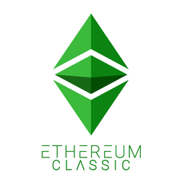




Ethereum Clients (2/5)
Ethereum is defined by a formal specification called the “Yellow Paper”
This is in contrast to, for example, Bitcoin, which is not defined in any formal way. Bitcoin’s “specification” is the reference implementation Bitcoin Core.
Ethereum’s specification, in addition to various Ethereum Improvement Proposals, defines the standard behavior of an Ethereum client.
There exist a variety of Ethereum-based networks that largely conform to the formal specification defined in the Ethereum Yellow Paper, but which may or may not interoperate with each other. Ethereum-based networks include Ethereum, Ethereum Classic, Ella, Expanse, Ubiq, Musicoin, and many others.

Slide 26
Ethereum Clients (3/5)
While mostly compatible at the protocol level, these networks often have features or attributes that require maintainers of Ethereum client software to make small changes in order to support each network. Because of this, not every version of Ethereum client software runs every Ethereum-based blockchain.
Most Common clients: Geth (Go Ethereum) and Parity (OpenEthereum)
Should I Run a Full Node? (Hardware Requirements)
The JSON-RPC Interface
Ethereum clients offer an application programming interface and a set of Remote Procedure Call (RPC) commands, which are encoded as JavaScript Object Notation (JSON).

Slide 27
Ethereum Clients (4/5)
Public Testnet Advantages and Disadvantages
There are some aspects of a public blockchain that you cannot test realistically on a testnet. For example, transaction fees, although necessary to send transactions, are not a consideration on a testnet, since gas is free.
Further, the testnets do not experience network congestion like the public mainnet sometimes does.
Local Blockchain Simulation Advantages and Disadvantages
For many testing purposes, the best option is to launch a single-instance private blockchain. Ganache (formerly named testrpc) is one of the most popular local blockchain simulations that you can interact with, without any other participants.

Slide 28
Ethereum Clients (5/5)
Remote Ethereum Clients
Remote clients offer a subset of the functionality of a full client. They do not store the full Ethereum blockchain, so they are faster to set up and require far less data storage.
Remote clients do not validate block headers or transactions. They entirely trust a full client to give them access to the blockchain, and hence lose significant security and anonymity guarantees.
Mobile Wallets and Browser Wallets are remote clients.
MetaMask injects a web3 instance into the browser JavaScript context, acting as an RPC client that connects to a variety of Ethereum blockchains (Mainnet, Ropsten/Rinkeby/Kovan testnet, local RPC node, etc.). Infura is the service provider that MetaMask uses to get information on and off of blockchains.

Slide 29
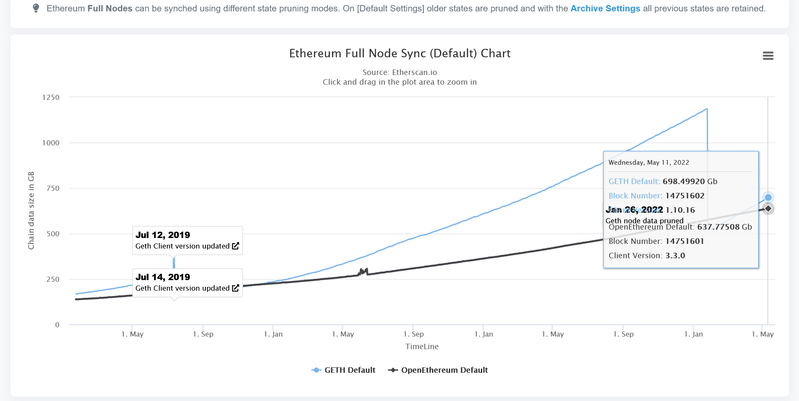
Ref. Ethereum Full Node Sync (Default) Chart

Slide 30
Cryptography and Wallets
Similar to that of Bitcoin
Public Key Cryptography (PKC) is used to control ownership of funds, in the form of private keys and addresses.
A private key uniquely determines a single Ethereum address, also known as an account.
Ownership of ether by EOAs is established through digital private keys, Ethereum addresses, and digital signatures.
A digital signature can be created to sign any message. For Ethereum transactions, the details of the transaction itself are used as the message.
Ethereum uses Keccak-256 (not SHA-256)

Slide 31
Transactions
Transactions are signed messages originated by an EOA, transmitted by the Ethereum network, and recorded on the Ethereum blockchain.
Another way to look at transactions is that they are the only things that can trigger a change of state, or cause a contract to execute in the EVM.
A transaction is a serialized binary message that contains the following data:
Nonce, Gas price, Gas limit, Recipient, Value, Data, the three components of an ECDSA digital signature of the originating EOA (v, r, s)

Slide 32
The Transaction Nonce (1/2)
A sequence number, issued by the originating EOA, used to prevent message replay.
Strictly speaking, the nonce is an attribute of the originating address; that is, it only has meaning in the context of the sending address.
The nonce is not stored explicitly as part of an account’s state on the blockchain. Instead, it is calculated dynamically, by counting the number of confirmed transactions that have originated from an address.
Two scenarios where the existence of a transaction-counting nonce is important: the usability feature of transactions being included in the order of creation, and the vital feature of transaction duplication protection.
It is important to note that the use of the nonce is actually vital for an account-based protocol, in contrast to the “Unspent Transaction Output” (UTXO) mechanism of the Bitcoin protocol.

Slide 33
The Transaction Nonce (2/2)
It is important to keep track of nonces if you are creating transactions programmatically, especially if you are doing so from multiple independent processes simultaneously.
The Ethereum network processes transactions sequentially, based on the nonce.
That means that if you transmit a transaction with nonce 0 and then transmit a transaction with nonce 2, the second transaction will not be included in any blocks. It will be stored in the mempool, while the Ethereum network waits for the missing nonce to appear.
Unfortunately, things get even more difficult if you are trying to do this concurrently.
Note that the transaction nonce is different from the nonce in the block header, which is used for the Proof-of-Work algorithm.

Slide 34
Transaction Gas
Gas is the fuel of Ethereum. Gas is not ether — it’s a separate virtual currency with its own exchange rate against ether.
Ethereum uses gas to control the amount of resources that a transaction can use, since it will be processed on thousands of computers around the world.
The gasPrice field in a transaction allows the transaction originator to set the price they are willing to pay in exchange for gas.
The price is measured in wei per gas unit. The higher the gasPrice, the faster the transaction is likely to be confirmed.
The gasLimit field gives the maximum number of units of gas the transaction originator is willing to buy in order to complete the transaction. (If your transaction’s destination address is a contract, then the amount of gas needed can be estimated but cannot be determined with accuracy)

Slide 35

Transaction Recipient
The recipient of a transaction is specified in the to field. This contains a 20-byte Ethereum address. The address can be an EOA or a contract address.
The Ethereum protocol does not validate recipient addresses in transactions. You can send to an address that has no corresponding private key or contract, thereby “burning” the ether, rendering it forever unspendable. Validation should be done at the user interface level.

Slide 36
Transaction Value and Data (1/2)
The main “payload” of a transaction is contained in two fields: value and data.
A transaction with only value is a payment. A transaction with only data is an invocation. A transaction with both value and data is both a payment and an invocation. A transaction with neither value nor data — that’s probably just a waste of gas.
Transmitting Value to EOAs and Contracts
For EOA addresses, Ethereum will record a state change, adding the value you sent to the balance of the address.
If the destination address is a contract, the EVM will execute the contract and attempt to call the function named in the data payload. If no data in your transaction, the EVM will call a fallback function, i.e. receive() in Solidity 0.6.x.

Slide 37
Transaction Value and Data (2/2)
Transmitting a Data Payload to an EOA or Contract
When your transaction contains data, it is most likely addressed to a contract address. That doesn’t mean you cannot send a data payload to an EOA — that is completely valid in the Ethereum protocol. However, the interpretation of the data is up to the wallet you use to access the EOA. Most wallets ignore any data received in a transaction to an EOA they control.
For contract addresses, the data will be interpreted by the EVM as a contract invocation. Most contracts use this data more specifically as a function invocation, calling the named function and passing any encoded arguments to the function.

Slide 38
Ref. Fallback Function in Solidity (1/2)
The solidity fallback function is executed if none of the other functions match the function identifier or no data was provided with the function call.
Only one unnamed function can be assigned to a contract and it is executed whenever the contract receives plain Ether without any data.
To receive Ether and add it to the total balance of the contract, the fallback function must be marked payable. If no such function exists, the contract cannot receive Ether through regular transactions and will throw an exception.

Slide 39
Ref. Fallback Function in Solidity (2/2)
Properties of a fallback function
Has no name or arguments.
If it is not marked payable, the contract will throw an exception if it receives plain ether without data.
Can not return anything.
Can be defined once per contract.
It is also executed if the caller meant to call a function that is not available
It is mandatory to mark it external.
It is limited to 2300 gas when called by another function. It is so for as to make this function call as cheap as possible.

Slide 40
Special Transaction: Contract Creation
One special case is a transaction that creates a new contract on the blockchain, deploying it for future use.
Contract creation transactions are sent to a special destination address called the zero address; the to field in a contract registration transaction contains the address 0x0.
This address represents neither an EOA nor a contract. It can never spend ether or initiate a transaction. It is only used as a destination, with the special meaning “create this contract.”
The zero address sometimes receives payments
Case 1: it is by accident, resulting in the loss of ether.
Case 2: it is an intentional ether burn. You should make your intention clear to the network and use the specially designated burn address instead.
0x000000000000000000000000000000000000dEaD

Slide 41
Separating Signing and Transmission
The three steps of creating, signing, and broadcasting a transaction normally happen as a single operation. However, you can create and sign the transaction in two separate steps. The most common reason is security.
The computer that signs a transaction must have unlocked private keys loaded in memory.
The computer that does the transmitting must be connected to the internet (and be running an Ethereum client).
If these two functions are on one computer, then you have private keys on an online system, which is quite dangerous.
Separating the functions of signing and transmitting and performing them on different machines (on an offline and an online device, respectively) is called offline signing and is a common security practice.

Slide 42
Offline Signing of Ethereum transactions

Slide 43
Transaction Propagation
Similar to that of Bitcoin
The Ethereum network uses a “flood routing” protocol. Each Ethereum client acts as a node in a peer-to-peer (P2P) network, which (ideally) forms a mesh network.
Transaction propagation starts with the originating Ethereum node creating a signed transaction.
The transaction is validated and then transmitted to all the other Ethereum nodes that are directly connected to the originating node.
On average, each Ethereum node maintains connections to at least 13 other nodes, called its neighbors.
Within just a few seconds, an Ethereum transaction propagates to all the Ethereum nodes around the globe.

Slide 44
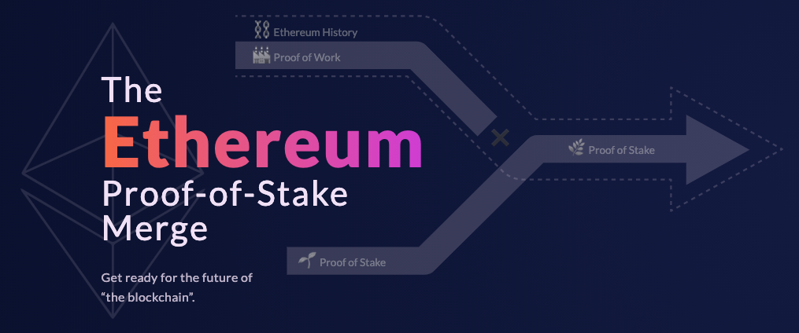
Recording on the Blockchain
Similar to that of Bitcoin but moved to PoS on 2022.9.15
While all the nodes in Ethereum are equal peers, some of them are operated by miners and are feeding transactions and blocks to mining farms, which are computers with high-performance graphics processing units (GPUs).
The mining computers add transactions to a candidate block and attempt to find a proof-of-work (PoW) that makes the candidate block valid.

Slide 45
Multiple-Signature (Multisig) Transactions
By using Bitcoin’s scripting capabilities, it is possible to create a Bitcoin multisig account which can only spend funds when multiple parties sign the transaction (e.g., 2 of 2 or 3 of 4 signatures).
Ethereum’s basic EOA value transactions have no provisions for multiple signatures; however, arbitrary signing restrictions can be enforced by smart contracts with any conditions you can think of, to handle the transfer of ether and tokens alike.

Slide 46
Ref. Ethereum Improvement Proposal-1559 (1/4)
Went live on August 5, 2021 (as part of the London hard fork)
EIP-1559 to the recue with the following goals
Make transaction fees more predictable
Before EIP-1559, Ethereum transaction fees were market-driven i.e gas price/fee dictated how quickly a miner would include a transaction in a block. In the past, during ICOs, network upgrades, or NFT craze where there is high network activity, it became very hard for network users and wallets to predict gasFees. This either results in overpaying so as to be included in a block, or underpaying and waiting a long time for the transaction to be included in the block, either way is not ideal.
EIP-1559 replaces the gas fees with a fixed-price sale. Now, people submitting transactions won’t have to guess as much about how much gas is required, as there will be an explicitly ‘baseFee’ to get to be included in the next block and a tip to pay the miner.
https://medium.com/coinmonks/why-eip-1559-is-important-5c24d592eace

Slide 47
Ref. Ethereum Improvement Proposal-1559 (2/4)
Reducing delays in transaction confirmation
Pre-EIP-1559, delays in transactions are caused because blocks are always full; filled with the highest paying transactions since the last block.
Post-EIP-1559, blocks can be 200% full i.e. whatever the set gasLimit for the block is, blocks with twice the gasLimit will be valid. As long as a transaction is sent with a fee higher than the baseFee and includes a miner tip (priorityFee), it will be included in the next handful of blocks.
Positive feedback loop between network activity and network supply
EIP-1559 allows for increase in the network capacity achieved by changing the maxGas limit per block from 12.5million to 25million gas (double of the block size).
Creating deflationary pressure
Under EIP-1559, baseFee is burnt as part of every transaction. The baseFee rises and falls with the demand for block space. During periods of sustained high demand for block space, baseFee rises and creates deflationary pressure on the supply of ETH.
Notes:
Note: By https://ethereum.org/en/developers/docs/gas/, The London Upgrade introduced variable-sized blocks to Ethereum. Each block has a target size of 15 million gas, but the size of blocks will increase or decrease in accordance with network demand, up until the block limit of 30 million gas (2x the target block size).

Slide 48
Ref. Ethereum Improvement Proposal-1559 (3/4)
EIP-1559 introduces a new baseFee that is burned rather than paid out to miners, and users can now specify a maximum fee and priority fee for transactions, rather than a gas price.
EIP-1599 transaction fee = baseFee + min(maxFee - baseFee, priorityFee)
baseFee: A fee that floats based on the network congestion and the most recent value can be fetched via a new JSON RPC call eth_feeHistory
priorityFee (also called a tip, miner’s tip): A fee to entice a block producer to include the transaction
maxFee: The highest network fee the user is willing to pay.

Slide 49
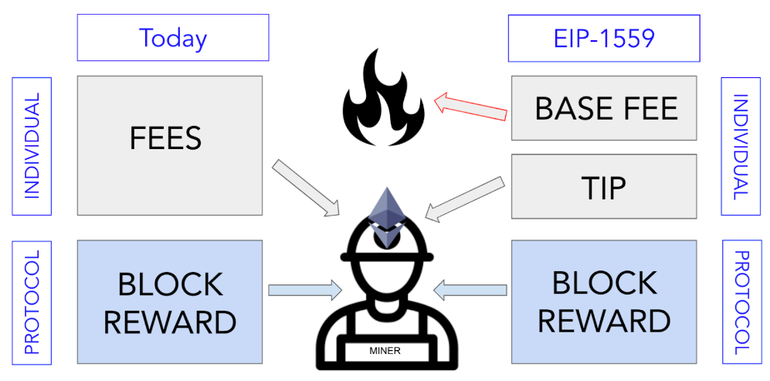
Ref. Ethereum Improvement Proposal-1559 (4/4)
(2ETH)
https://medium.com/coinmonks/what-eip-1559-means-for-users-miners-and-wallet-providers-6c10c507df2d
Gas and fees | ethereum.org
EIP-1559 & Improving How Gas Fees Work | MetaMask

Slide 50
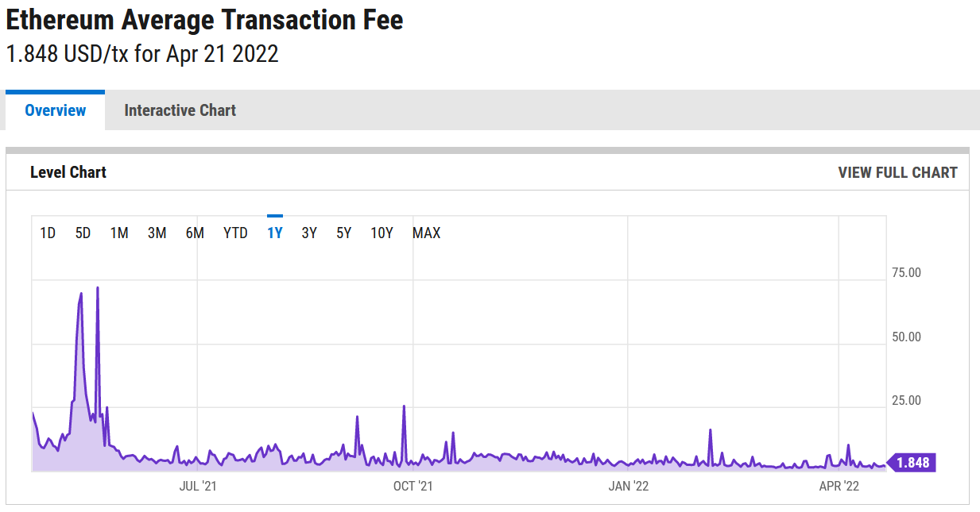
Ref. Ethereum Average Transaction Fee
https://ycharts.com/indicators/ethereum_average_transaction_fee

Slide 51
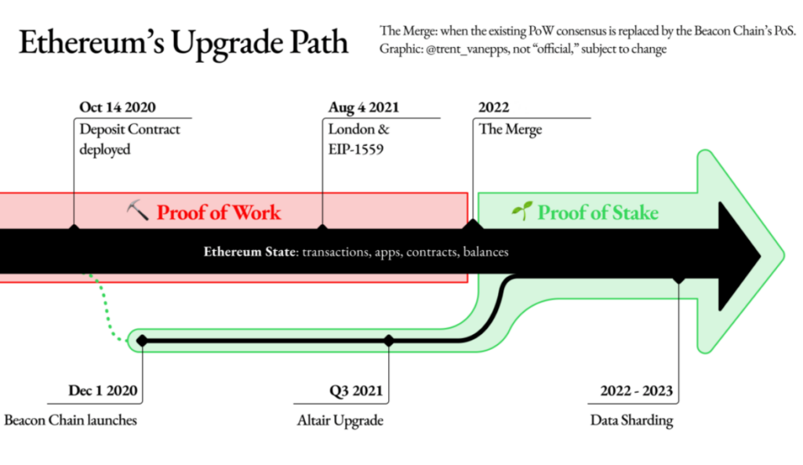
Ref. Ethereum Upgrades

Slide 52
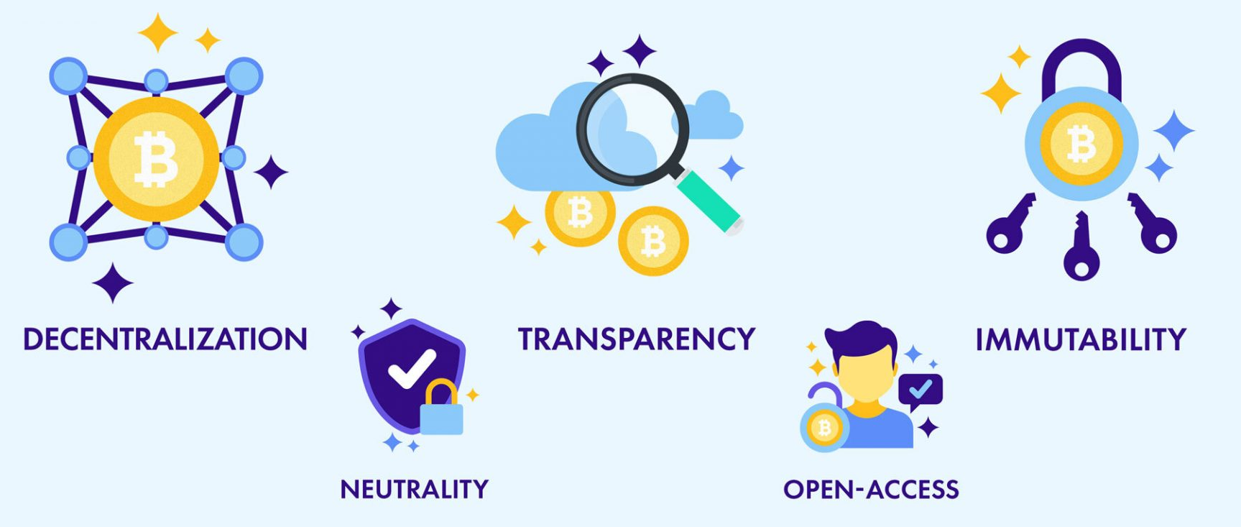
Ref. Major Characteristics of Blockchain
https://coingate.com/blog/post/blockchain-explained

Slide 53
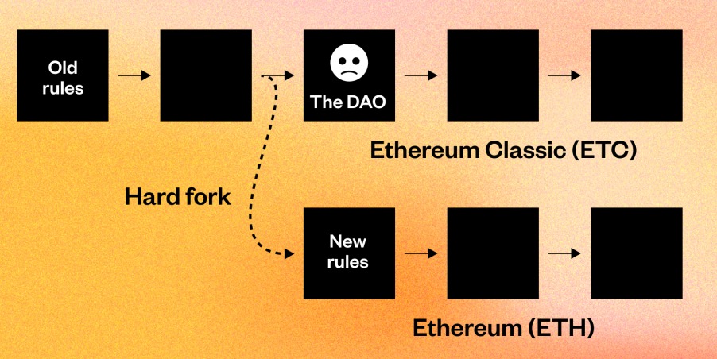
Ref. Controversial Hard Fork for The DAO attack
https://www.gemini.com/cryptopedia/the-dao-hack-makerdao
http://cryptohustle.com/5-reasons-why-the-dao-bailout-was-bad-for-ethereum/
The hard fork effectively rolled back the Ethereum network’s history to before The DAO attack and reallocated The DAO’s ether to a different smart contract so that investors could withdraw their funds. This was extremely controversial — after all, blockchains are supposed to be immutable and censorship-resistant.

